Slide 1
Hands-on Neo4j: US Road Network Analysis
MSDA9215: Big Data Analytics
Lecturer: Temitope Oguntade
AUCA
June, 2026

Slide 2
Group Members
SHYAKA Ivan 101229
Rwego Marie Vaillainte 101225
Tumukunde Sandra 101483

Slide 3
Introduction
This project is about applying the Neo4j database hands-on using a US road network scenario characterizing a graph database network where nodes are represented by road intersections and edges represented by the roads connecting those intersections. A graph database was identified as the most suitable database type for this road network analysis due to the high dependency of relationships between intersections through identifying paths across 87,575 nodes and 121,961 roads in addition to the fact that relational databases requires several Join operations which can be time and memory consuming while Neo4j traverses connections natively. This report covers the analysis performed to identify several metrics like shortest path, high degree intersections, centrality of intersections, dashboard, and visualizations.
The analysis was conducted using Neo4j Community Edition 5.26.0 as the graph database engine, Python with the NetworkX library for algorithmic computation, and Plotly for interactive dashboard visualizations.

Slide 4
Dataset Description
The dataset represented the United States (US) road network through a geometric graph with vertices representing road intersections on the map and edges represented by roads between these points/intersections. The data was presented by an identification(id), x-coordinates and their y-coordinates and their edge entries without distance values that had to be calculated from the provided coordinates through the Euclidean distance formula. . The dataset comprise of 87,575 intersections and 121,961 roads with sparse relationship and an average degree of relationship per node of 2.8.

Slide 5
Tools and Environment
The analysis required the ability to store the data needed for analysis, compute the algorithms to identify the outputs of the analysis and the visualization of data. Neo4j was used as type of graph database that stores data as nodes and relationships which makes it efficient for queries to find the paths from one node to another. However the community edition does not include GDS plugin or APOC used for advanced algorithms like betweeness Centrality. Hence, the use of NetworkX instead. The algorithms were computed via VS code using python language. Using plotly we were able to create interactive visualizations and dashboard as well as pandas for data manipulation and organization.

Slide 6
Data Loading Process
Using the parsing function, we were able to open and read the usa.txt file containing the 87,575 nodes and their 121,961 edges. A unique constraint was created on the nodes to always have a node_id have to prevent duplicates while loading them in batches to speed up loading. Each edge pair was calculated for both directions for Dijkstra to explore freely without getting stuck and a merge instead of create was used to avoid duplication of relationships

Slide 7
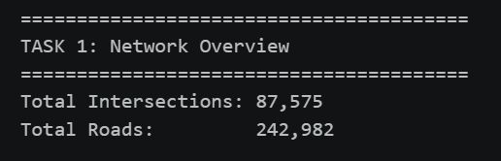
Task 1: Network Overview
The objective of this task was to confirm if the data was loaded correctly and show the statistics of how many intersections and roads we have in our dataset. Where a count all intersection nodes and road relationships were calculated to identify them. The results showed a total of 87,575 total intersections and 242,982 total roads which was made possible through the 2 directions expected to be stored.

Slide 8
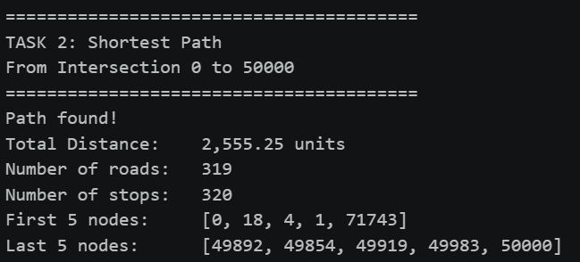
Task 2: Shortest Path
To find the most efficient route between two intersections, a Dijkstra algorithm was implemented via NetworkX library. This algorithm allows calculation of costs to reach the destination and identify all the costs according to the relationship therefore identify the shortest path between two intersections. In the implementations we used intersection 0 as the source and intersection 50,000 as the destination which provided the result of 2,55.25 units.

Slide 9
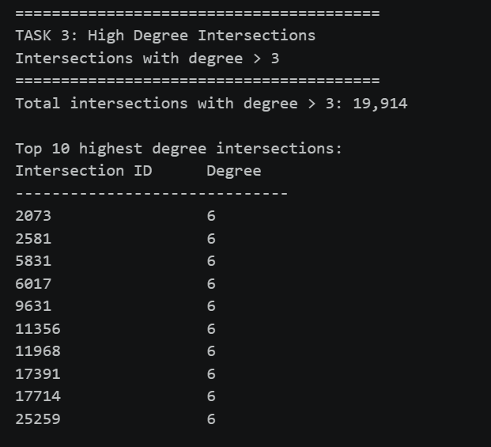
Task 3: High Degree Intersections
The degree is considered as the number of roads
connected to a single node/intersection.
A threshold of degree>3 was chosen for
the network average degree is 2.8 so this
level of degree shows the above average
connections per intersection.
22.7% was found exceeding average degree
with maximum degree of 6 where
the most common was degree 4.

Slide 10
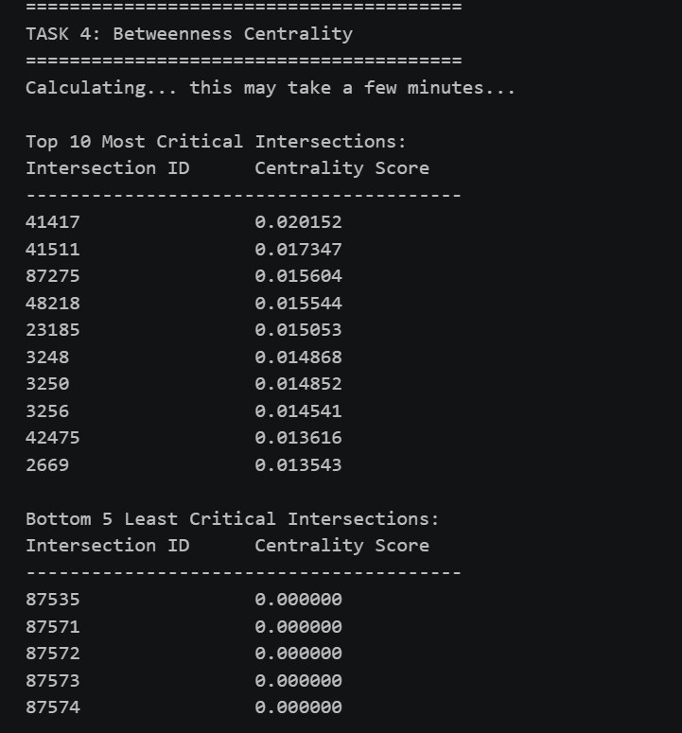
Task 4: Betweenness Centrality
This metric measures how many shortest paths
pass through a node/intersections
where the node with a high score
shows a critical bridge in the relationships.
To identify it we used a K=500 sampling
to reduce computation time which a gave us a
result with 85-90% reliable estimate.

Slide 11
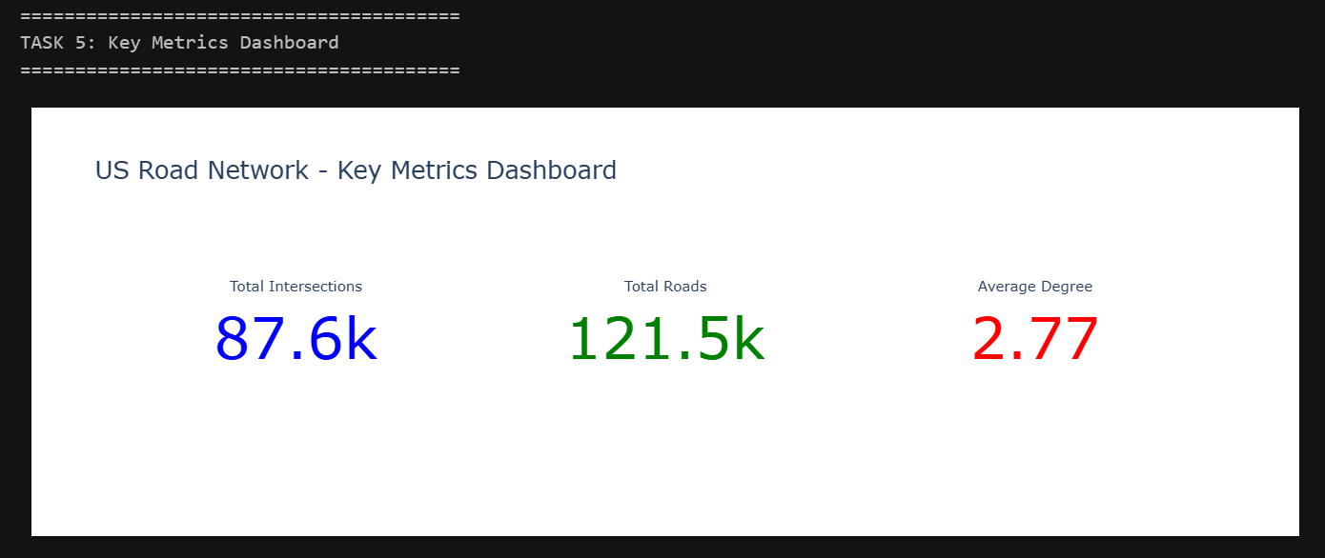
Task 5: Dashboard and Visualizations
A plotly dashboard was built to visualize key network metrics across five tasks. Three indicator cards displayed the number of interactions, roads and average degree.

Slide 12
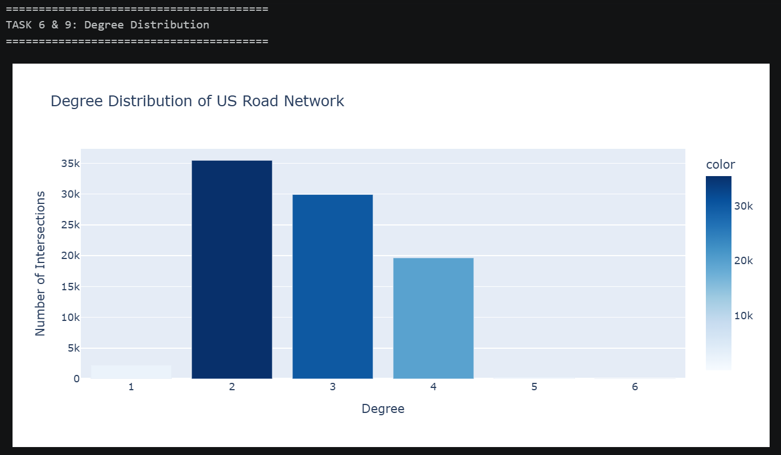
Task 6: Degree Distribution Bar Chart
This bar chart shows how many intersections have each degree where the degree 2 is most common which confirms the sparse network nature and dgree 5 and 6 nearly invisible.

Slide 13
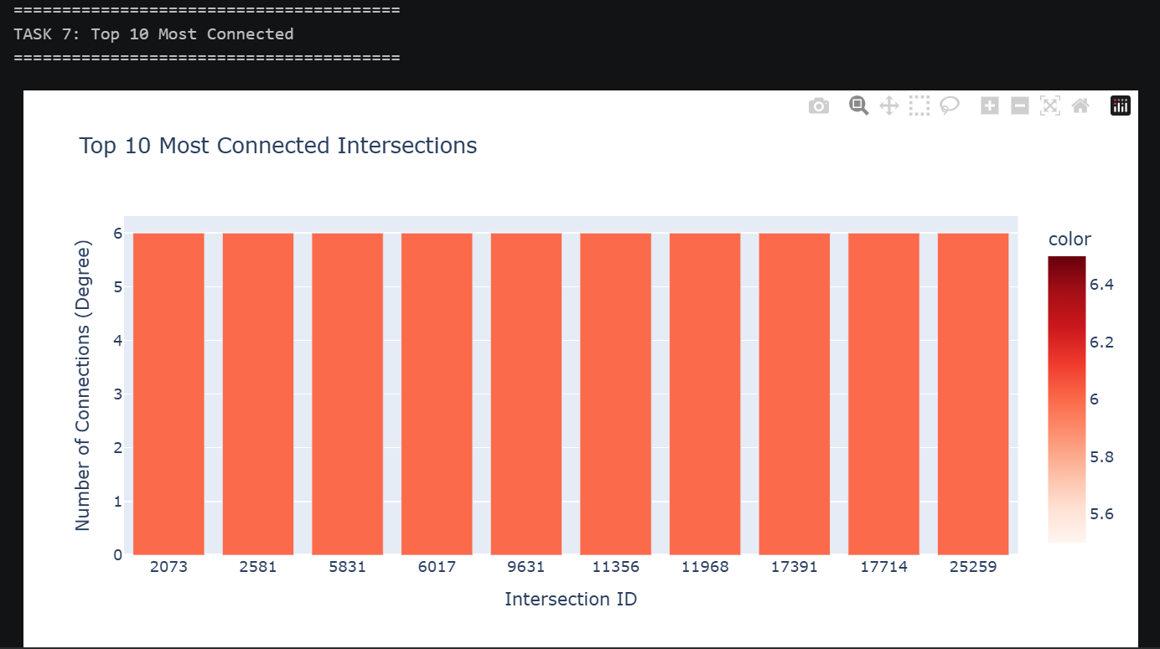
Task 7: Top 10 Most Connected Intersections
The bar chart shows all 10 top intersections sharing the same level of degree of intersections which is 6. where degree 2 and this shows that there was no single hub in the network which is dominant to the others.

Slide 14
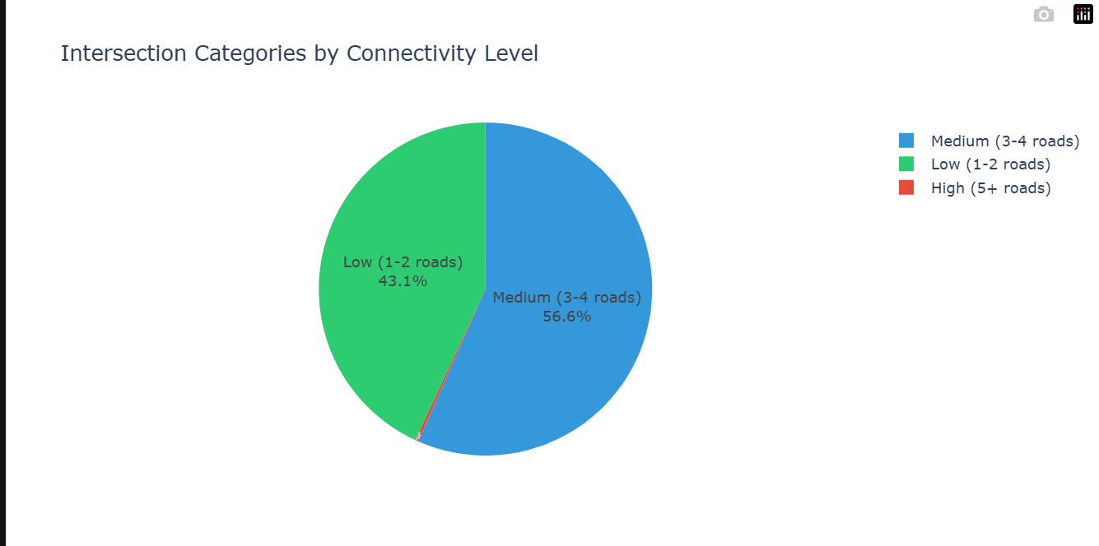
Task 8: Intersection Categories Pie Chart
The pie chart shows the categories of
intersection categorized into three
categories form low consisting of
1 to 2 roads showed by 43%,
Medium consisting of 3 to roads
showed by 56.6% to High consisting
5+ roads showed by 0.3% showing
99.7% of all intersections are
simple confirming sparse network.

Slide 15
Conclusion
This analysis demonstrates that Neo4j is a powerful and efficient tool for large-scale road network analysis, providing insights that would be computationally impractical with traditional relational databases.
Project repository: https://github.com/Ivan-SHYAKA/neo4j-us-road-network.git

